Slide 1

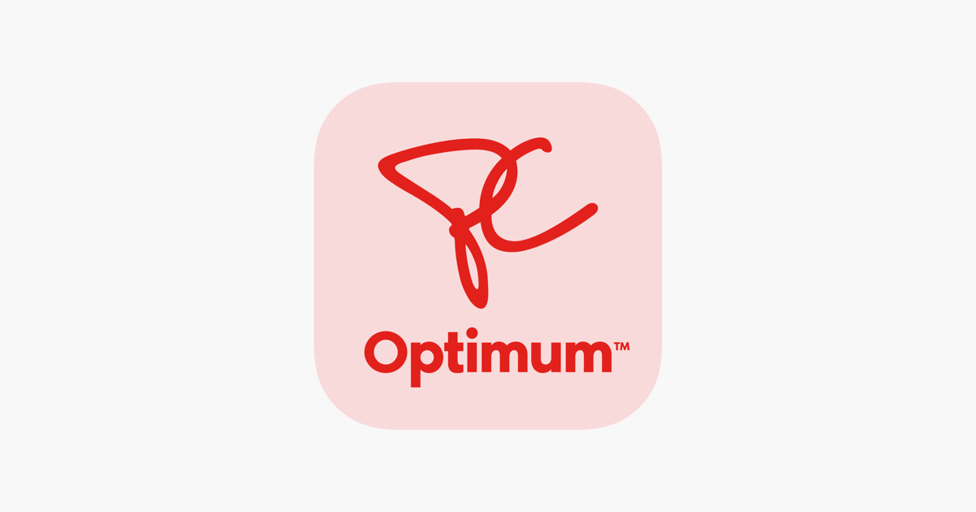
ONBOARDING EXPERIENCE
AND AUDIT
Presented By: DEVANSH SOLANKI
142127224
MKM-916

Slide 2


Agenda
3 | WHAT AND HOW ??
4 | ONBOARDING
5 | ROUTINE COMMUNICATION
6 | SOCIAL INTERACTION
8 | ENGAGEMENT AND FEEDBACK
9 | COMPETITOR ANALYSIS
10 | SUMMARY OF JOURNEY
11 | RECOMMENDATIONS
12 | CONCLUSION
13 | REFERENCE PAGE

Slide 3


WHAT AND HOW IT WORKS ?
PC Optimum is one of Canada's best loyalty programs, brought by Loblaw Companies Limited. It actually combines the past loyalty programs of both the PC Plus and Shoppers Optimum programs where members can earn points on items purchased daily at Loblaw-owned stores that include, among others, Loblaws, Shoppers Drug Mart, No Frills, and Joe Fresh. A member gets to accumulate points that may be redeemed for an instant discount to give more value to customers for groceries, pharmacy items, and other essentials.
The PC Optimum program is a loyalty program that lets you gain points on items bought at participating stores, gives access to bonus points events; and when you download the app or create an online account, also gives offers tailored just for you.
With the PC Financial Mastercard you'll earn PC Optimum points for purchases made on the card everywhere you shop. But when you create a PC Optimum online account at PC Optimum with even more benefits.
The purpose of the analysis will be to try and evaluate how far the onboarding process of PC Optimum engages a new user in relation to the creation of frictionless experiences through and through. The discussion now examines every touch-point a user has with the program-from account activation to personalized communication.

Slide 4
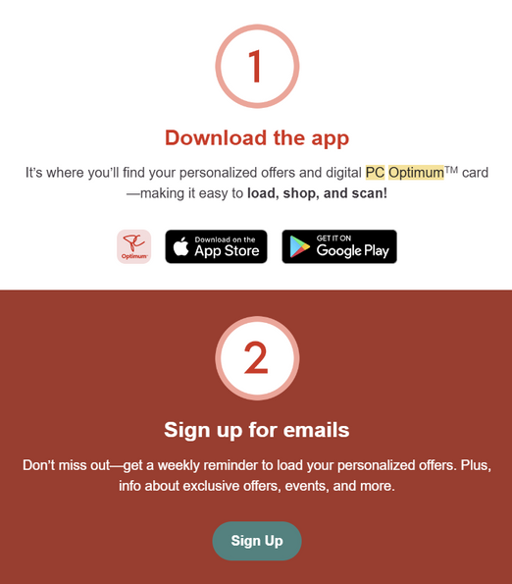
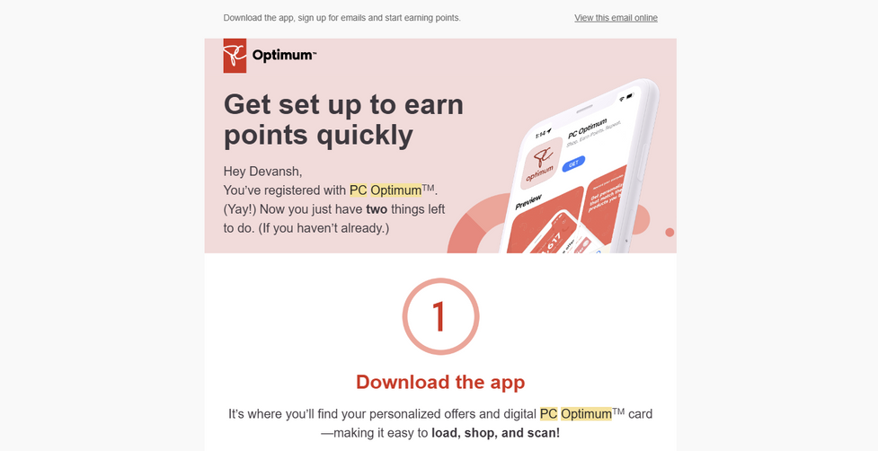
ONBOARDING
Creating a PC Optimum account was rather easy. Once I downloaded the app and created an account, it asked for basic information: e-mail, phone number, and personal information.
I opted in for notifications so that way I would be notified about the latest offers. An initial welcome e-mail was also received with further instructions on how to operate the app and maximize the value of the loyalty program. That felt very intuitive and inviting, though there are minor ways to improve the first run experience, like an interactive walkthrough or brief tips for new users.

Slide 5
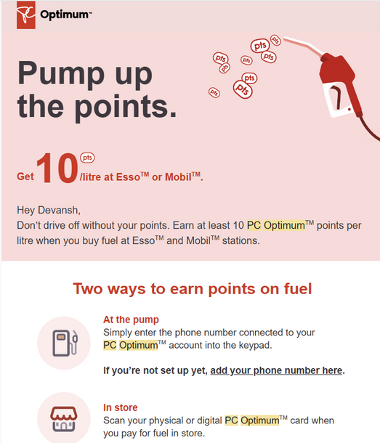
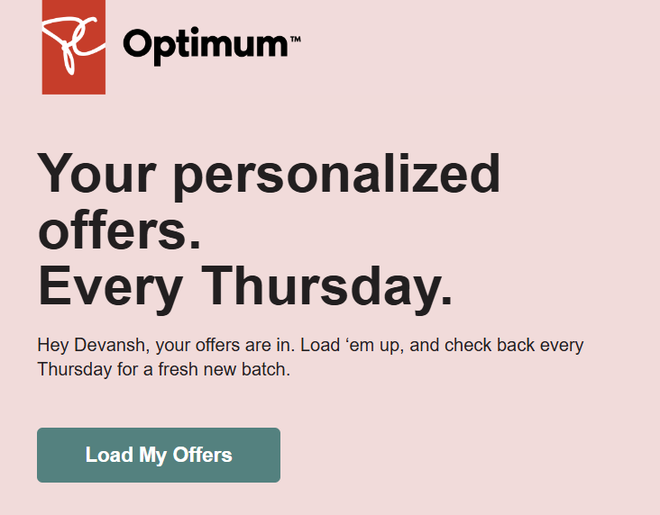
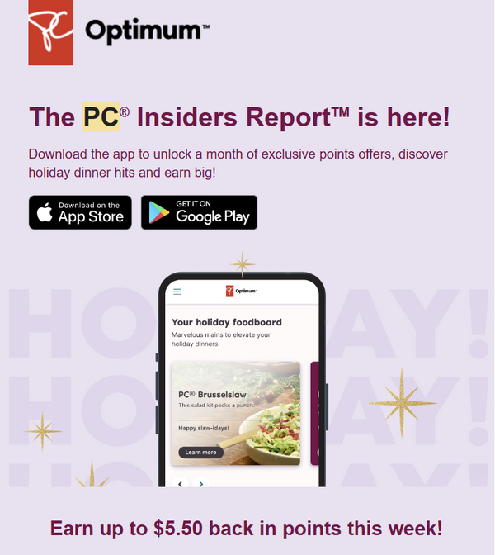
ROUTINE COMMUNICATIONS

Slide 6
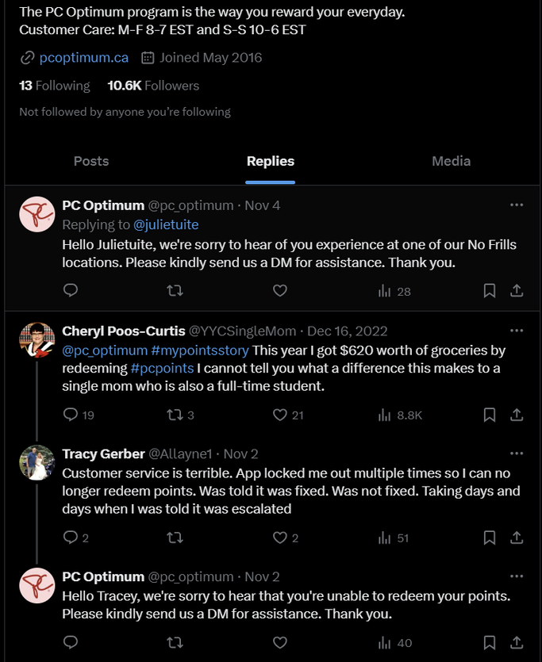
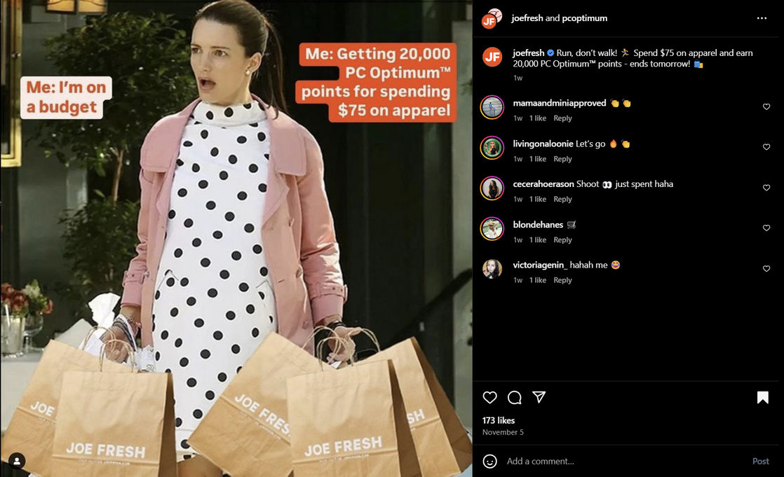
SOCIAL INTERACTIONS
PC optimum has been engaging and interactive on Instagram as they put timely posts and reels about what a customer can have and what they are missing out on.
Personally, PC Optimum has not utilized “x” at all. There is no content posted after 2022, using this platform to answer user complaints.

Slide 7
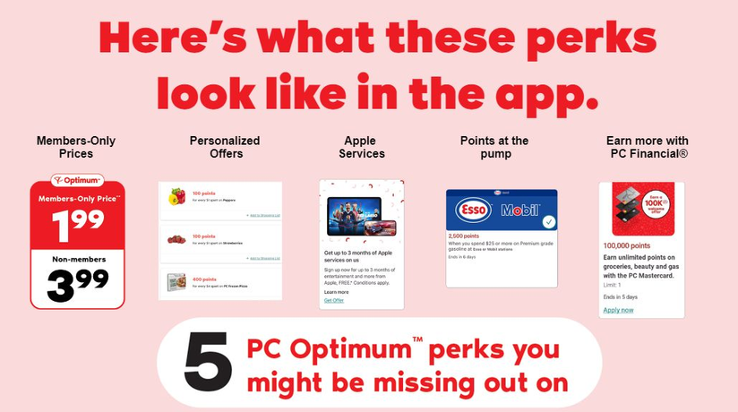
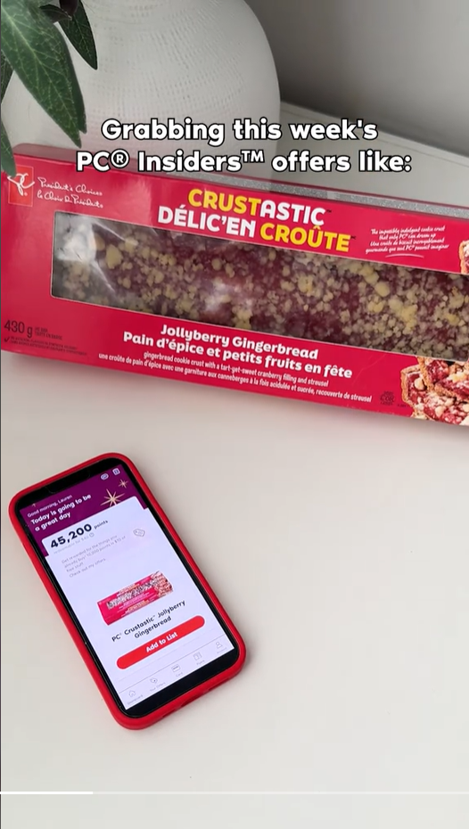
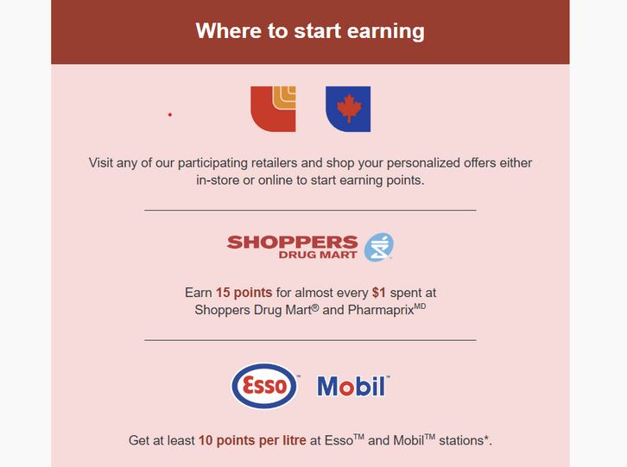
some more content through mails and i believe their main source of interaction is email.
TIKTOK has been not at all helpful. The content it posts is directly taken from Instagram. Market capturing is also not up to the mark.

Slide 8
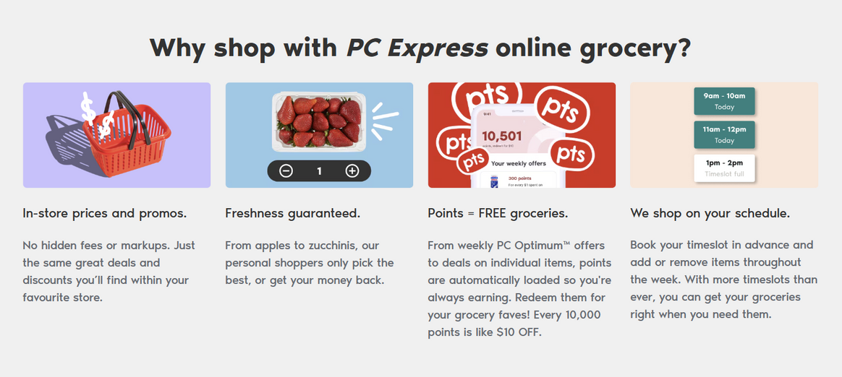
ENGAGEMENT AND FEEDBACK POSSIBILITIES
Within the first three weeks of using PC Optimum, direct opportunities to provide feedback via surveys, product reviews, or similar channels did not pop up. Such limited opportunity for interaction reduces the feeling of two-way relationship feelings between the user and the brand.
Providing a prompt to offer feedback following some initial interactions or purchases could foster this, showing quite directly the commitment of PC Optimum to understanding its members' experiences.
These feedback channels make users feel valued, showing that PC Optimum is concerned with customer satisfaction and committed to upgrading the service with user input.
The options for giving feedback could be more engaging if they had an incentive of gaining some points by participating in surveys or a space to put suggestions. Overall, these features foster a two-way relationship, thereby helping in building customer loyalty by making users feel involved in shaping their experience.

Slide 9
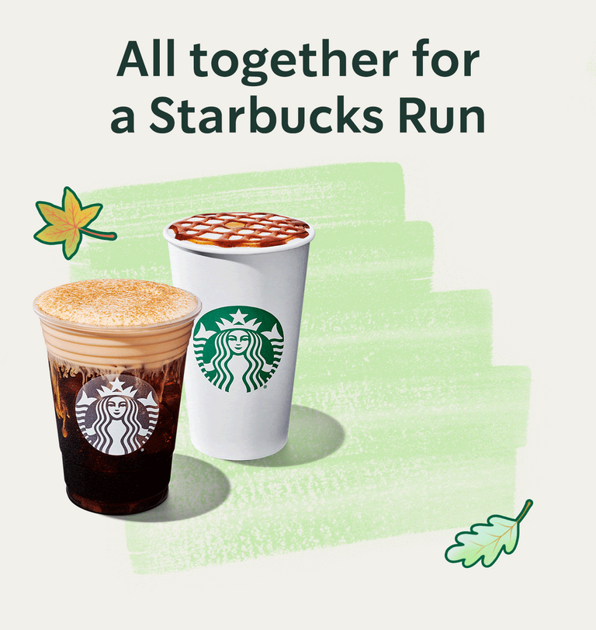

HOW COMPETITORS ARE DOING ?
Comparing the onboarding experience of PC Optimum with one of its competitors, say the Starbucks Rewards, there are clear differences. PC Optimum does a great job in onboarding-seamless sign-up and a variety of offers toward groceries, health, and beauty. In contrast to Starbucks Rewards, which has mainly beverage rewards and product discounts, the reward system for PC Optimum feels more versatile and practical for everyday shopping.
Yet, PC Optimum still has quite a bit of room for improvement on personalizing these offers, just like Starbucks Rewards does. For example, Starbucks refreshes personalized offers with new items on a regular basis. It also takes user buying history into consideration, rewarding users for trying something new or coming in at special times by giving them more stars. PC Optimum could easily do the same thing-offering each user more in line with their tastes and notify users of deals specific to their buying trends.
In summary, onboarding in PC Optimum is very smooth and flawless, building a nice first-time experience. It needs more adaptation to dynamic personalization strategies that its competitors use in order to keep users active for a longer period of time.

Slide 10
BREIF SUMMARY OF MY JOURNEY
In my month-long onboarding with PC Optimum, the program itself set up very easily; it kept the communication pretty regular, be it through email-maybe eight to ten emails-or even sponsored Instagram ads.
A few of those ads actually were directed toward my shopping habits, so they did try to speak more personally and reach out to me. However, the degree of personalization was lower than expected with regard to the cadence of offers for direct targets; it was rather more of a generic experience.
What is more, PC Optimum did not provide me with an avenue for direct feedback or interactive onboarding features through which I could engage in the program. While PC Optimum tried to make the connection, as in all cases, the effort was not quite as effective as I had hoped, with room for improvement to make it more dynamic and personalized.
Strengths
Easy Onboarding: The process of activating the account was quick, and the setup was easy, hence making it pretty easy to get started with the program right away.
Regular Notifications: PC Optimum kept me pretty informed; I received at least 8-10 emails in one month regarding their promotions and availability of offers.
Practical Rewards System: The point system within the program is something workable. It rewards primarily for consumable purchases, such as groceries and items from the pharmacy.
Weakness
Less Personalized: Communications were not really personalized to my liking or preference.
Lack of Interaction: Without any option to give feedback or further interact with the program.
One-Way Communication: It felt like one-directional communication, basically, where this onboarding experience should be interactive and two-way in nature in terms of nurturing the loyalty of customers.

Slide 11

WHAT PC OPTIMUM SHOULD LOOK UPON
More Personalization and Segmentation: PC Optimum can enhance its personalization in the way it utilizes the data more actively to segment users based on their preferences, spending habits, and interaction. Customized promotions may be triggered by user activities similar to segmented campaigns for successful loyalty programs, creating a sense of relevancy and value. Companies achieve better engagement and loyalty by offering rewards in line with customer needs thanks to predictive analytics for highly personalized offers.
Comprehensive Onboarding to Key Guided Features: Building confidence in PC Optimum would mean it might want to include a guided tutorial for its members on key features, including how to navigate through earning and redeeming points. This is very common in customer success onboarding to lock in usability and immediate value. Allow easy access in the app to FAQs, tutorial videos, or interactive guidance so that new members may feel supported from the beginning.
Regular Feedback Loops and Surveys: Short, user-friendly surveys or even feedback options introduced through the app or via emails give voice to customers, turning what was a one-way relationship into a two-way conversation. Giving incentives for feedback with small rewards or bonus points will increase participation and provide valuable insights into improving the loyalty experience. Effective onboarding relies on capturing customer sentiment early to fine-tune the experience.
Omnichannel Engagement: Consistency of user engagement on social media, emails, and push notifications will make for wider visibility of the brand and continuity of engagement. Gamifying elements in the form of challenges or key milestones reached could also be embedded into the app as a means of enticing users to try something new or search out an offer. Many successful loyalty programs today leverage quizzes, challenges, and badges as ways to enhance user interaction and create a closer relationship with the customer.

Slide 12


CONCLUSION
Onboarding is a crucial process that constructs the very foundation of a long-lasting, loyal customer base. In building this, PC Optimum can make the users feel guided, appreciated, and engaged with the service at all times. Effective onboarding sets users up for success with clear, personalized communication for a rewarding experience unique to them. Thus, in return, can build loyalty and prevent churning, since valued customers are more likely to be willing to participate in the program continuously. In this manner, an expanded focus on these areas will revolutionize the initial experience for PC Optimum users and set the stage for both immediate satisfaction and long-term engagement.

Slide 13

Resource Page
Process Street. (2024, March 5). How to Maximize Loyalty with Customer Success Onboarding. Process Street | Process & Project Management Software | the Collaboration Platform for Teams That Care About Quality & Compliance. https://www.process.st/customer-success-onboarding/
Innovators choose Wonder. (2020,May 20). https://start.askwonder.com/insights/understand-benefit-onboarding-process-loyalty-programs-communication-components-qr9j5e2el
What is the PC Optimum Program? | PC Financial. (n.d.). https://www.pcfinancial.ca/en/learning-hub/faqs/pc-optimum/what-is-the-pc-optimum-program/

